Slide 1
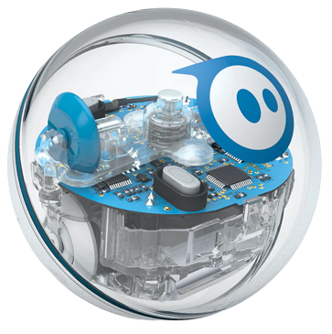
Sprint 4 Presentation
By Aidan, Bryan, and French

Slide 2
Challenges Faced
Room availability
Robot inconsistency
Work division (collaboration)
Finding times to meet
Time constraints and time management

Slide 3
Roles of each team member
French: Programmer; robot tester and video taker
Aidan: System Design Document designer and supporting flowchart designer
Bryan: Sensor Data Diagram and System Design Document

Slide 4
Software Engineering Reflection
This project has given us a lot of insight on how projects in Software Engineering are carried out. Naturally, we learned more about sphero robots and the block code used to program them. More importantly though, we learned how to properly prepare to work on such a project by first laying out our goals and devising a plan to efficiently reach that goal. Collaboration and splitting the workload was a key factor that allowed us to get all requirements for each sprint done on time. Another key that played an important role in our success was asking for help from our teammates in situations where they may have more knowledge on a task that we were assigned to work on.

Slide 5
What would we do differently
Should have set up multiple days to record the video of the robot instead of one day before incase the robot did not perform well
Utilize the gantt chart to time manage. The first time we did, but we did not use it in the second two sprints and just filled it out at the end

Slide 6
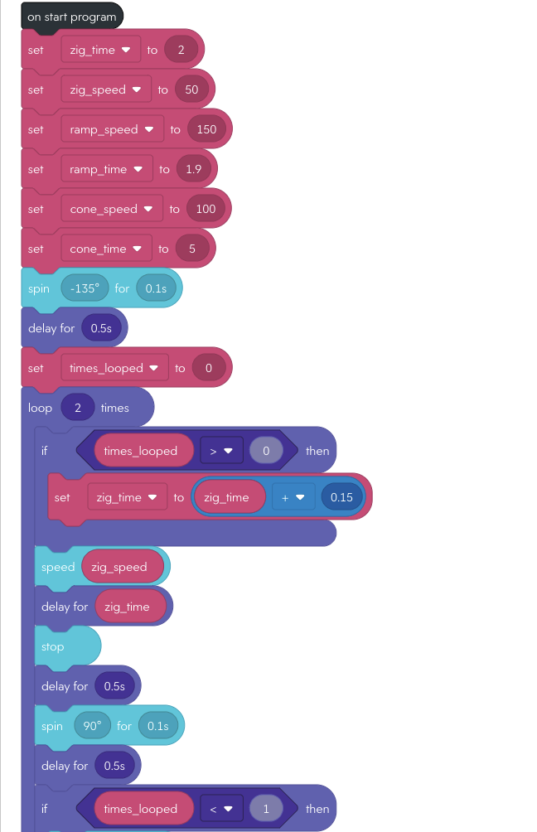
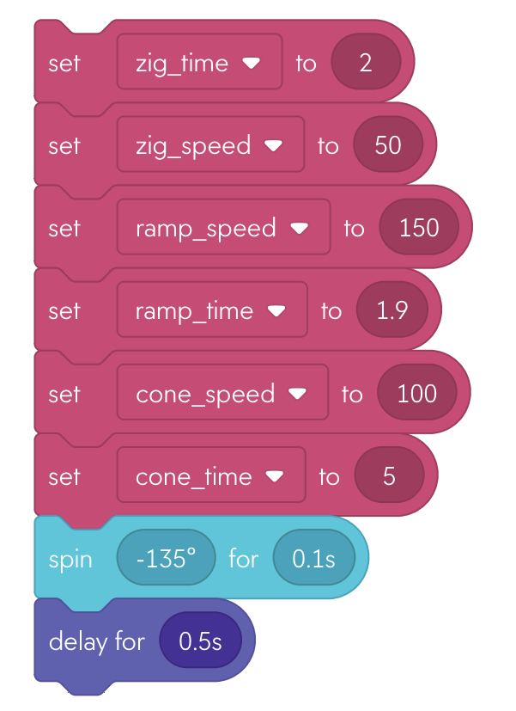
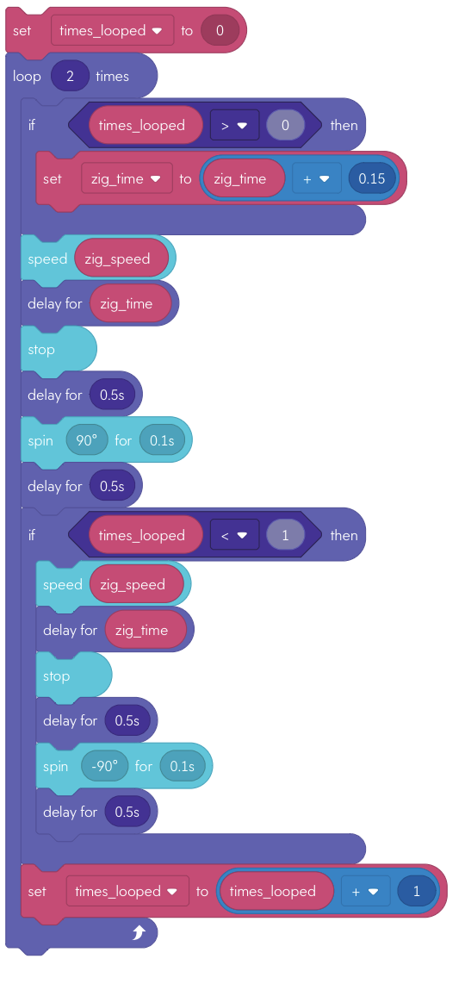
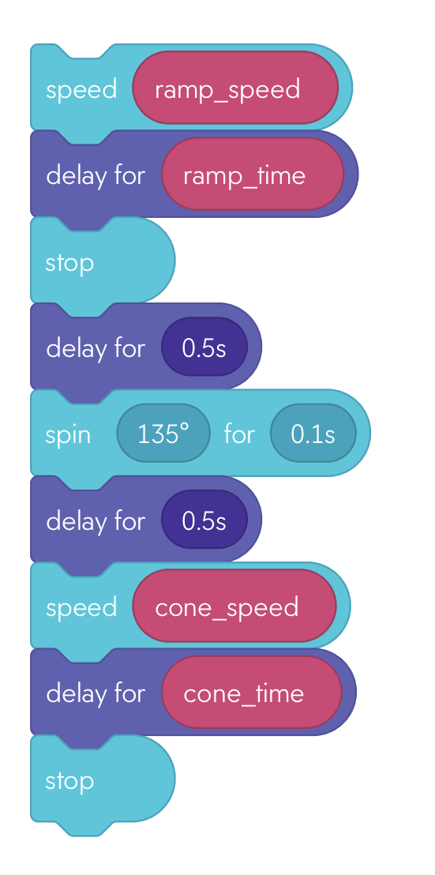
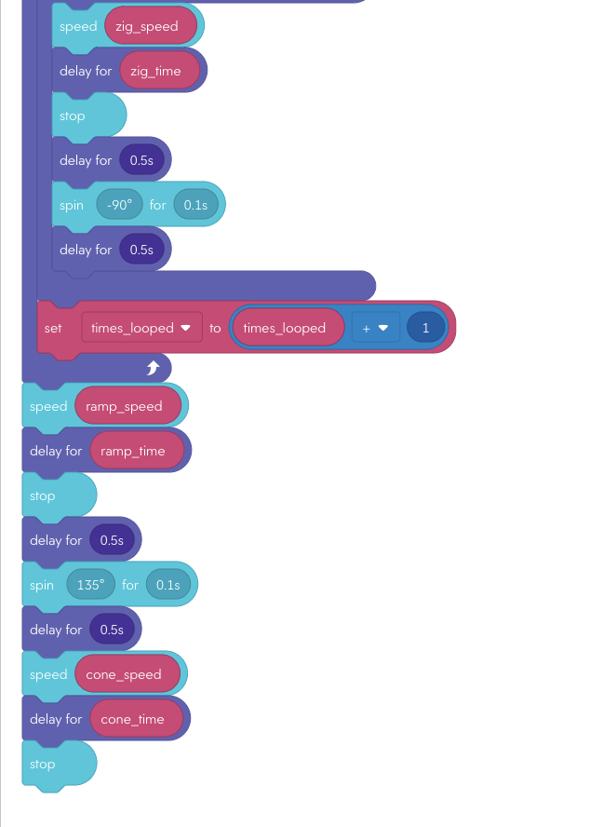

Set Variables
Weave Through Bottles
Jump Ramp and Knock Down Markers

Slide 7
